Slide 1
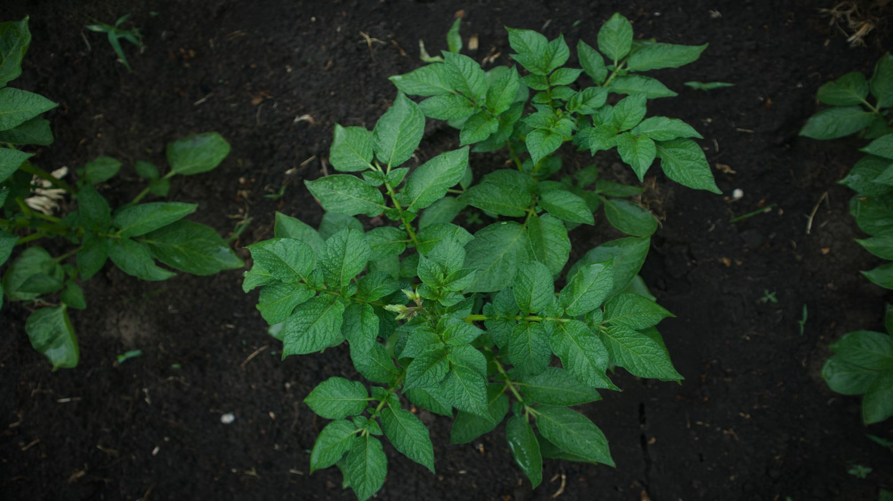
Potato Leaf Disease Classification Using Deep Learning
Course Code: PGDDS 203
Course Name: Data Science Project
Submitted By:
Asik Kadir (905251003)
Apurba Halder (905251027)
Tridib Das Sourav (905251023)
Mohammad Shahadat Hossain (905251015)
Submitted To:
Afzal Hossain
Assistant Professor
Post Graduate Diploma in Data Science
United International University

Slide 2
Introduction
Potato crops are highly vulnerable to diseases like Early Blight and Late Blight, which can cause severe yield loss if not detected early. Traditional diagnosis through manual inspection is slow, subjective, and often inaccurate.
To solve this, we developed an automated disease detection system using a Custom Convolutional Neural Network (CNN) that classifies potato leaves into Early Blight, Late Blight, or Healthy.

Slide 3
Problem & Objectives
Problem Statement
Potato blights spread rapidly and severely impact global crop yield.
Manual diagnosis is slow, subjective, and error-prone.
Need for fast, automated, accurate disease detection using images.
Objectives
Build a Custom CNN without pretrained models
Achieve high classification accuracy
Develop a Tkinter GUI for real-time testing
Provide a portable solution for farmers & researchers

Slide 4
Dataset Overview
Dataset Description
Dataset from PlantVillage
3 Classes:
Potato_Early_Blight
Potato_Late_Blight
Potato_Healthy
Preprocessing
Image resizing (256×256)
Pixel normalization
One-hot encoding
Shuffle + train/val/test split

Slide 5
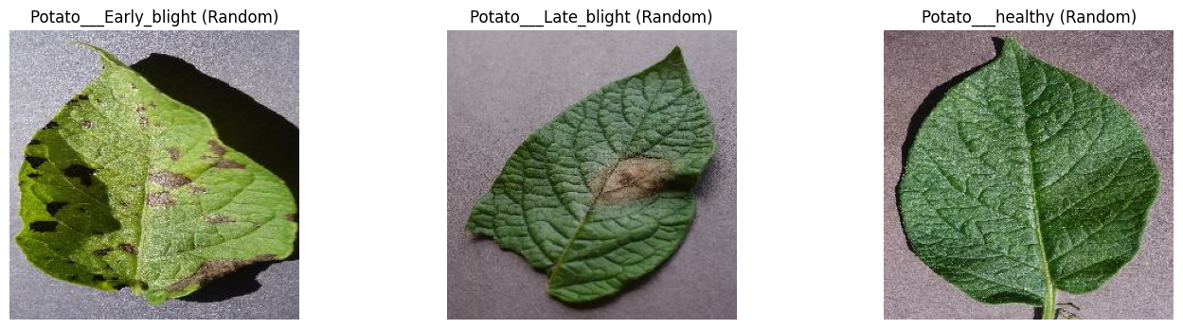
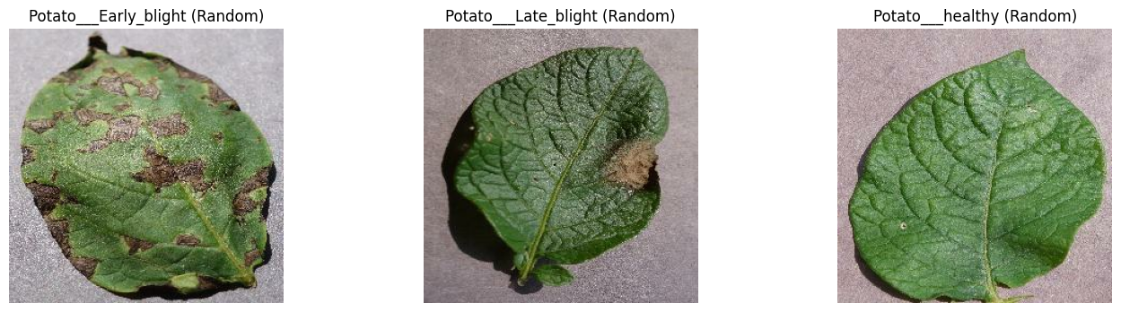
Dataset Overview

Slide 6
System Workflow
End-to-End Pipeline
Load dataset
Preprocess images
Train Custom CNN
Evaluate model
Save model → potato_model.h5
Build Tkinter frontend
User uploads image → Model predicts disease

Slide 7
Custom CNN Architecture
Architecture Overview
Conv2D (32 filters) + MaxPool
Conv2D (64 filters) + MaxPool
Conv2D (128 filters) + MaxPool
Conv2D (128 filters + L2 Reg.) + MaxPool
Flatten
Dense (128, L2 Regularization)
Dense Output (Softmax, 3 classes)
Purpose
Extract low-level → high-level features
Reduce overfitting using L2 regularization
Produce class probability distribution

Slide 8
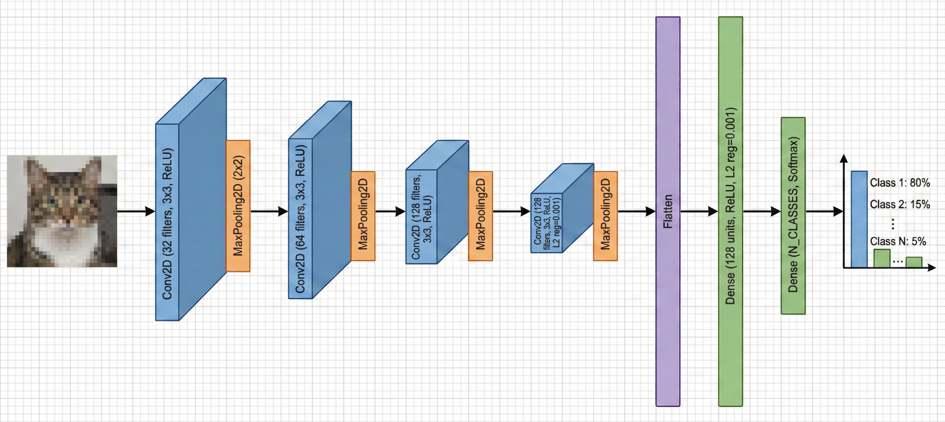
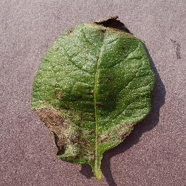
Custom CNN Architecture

Slide 9
Model Training Details
Training Setup
Optimizer: Adam
Loss: Categorical Cross Entropy
Metrics: Accuracy
Batch size: 32
Epochs: Based on validation convergence
Key Notes
Stable training
No overfitting due to regularization
Strong train–validation consistency

Slide 10
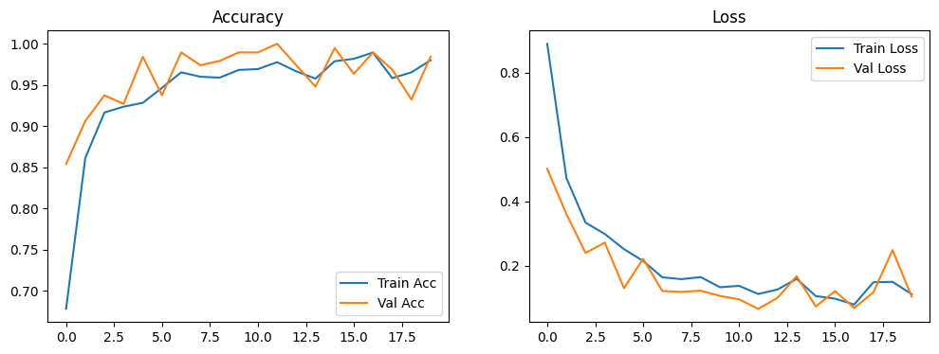
Model Training Details

Slide 11
Classification Report
Overall Test Accuracy: 98%
Key Insights
Perfect precision for Early Blight
Strong model generalization
Excellent performance despite class imbalance
Class | Precision | Recall | F1-Score
Early Blight | 1.00 | 0.96 | 0.98
Late Blight | 0.97 | 0.99 | 0.98
Healthy | 0.94 | 1.00 | 0.97

Slide 12
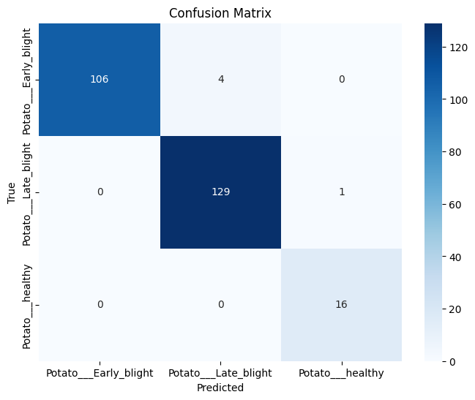
Confusion Matrix
Observations
Strong diagonal → high correct predictions
Minor confusion between Early & Late Blight
All healthy leaves predicted correctly (100% recall)
Errors caused by visual similarities in advanced infection

Slide 13
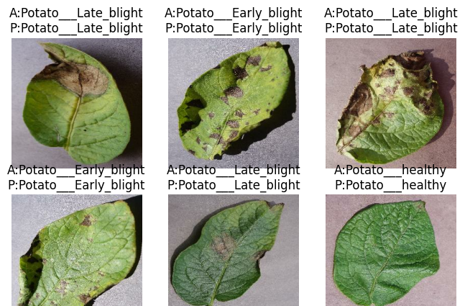
Sample Predictions

Slide 14
Conclusion
Conclusion
Custom CNN achieved 98% test accuracy
Successfully differentiates Early Blight, Late Blight, Healthy
Tkinter GUI enables real-world usability
Lightweight model without pretrained networks

Slide 15
Thank You

